Slide 1
ScarecrowBot
Capstone Project for SEIS 744 – IOT Eric Buhr

Slide 2
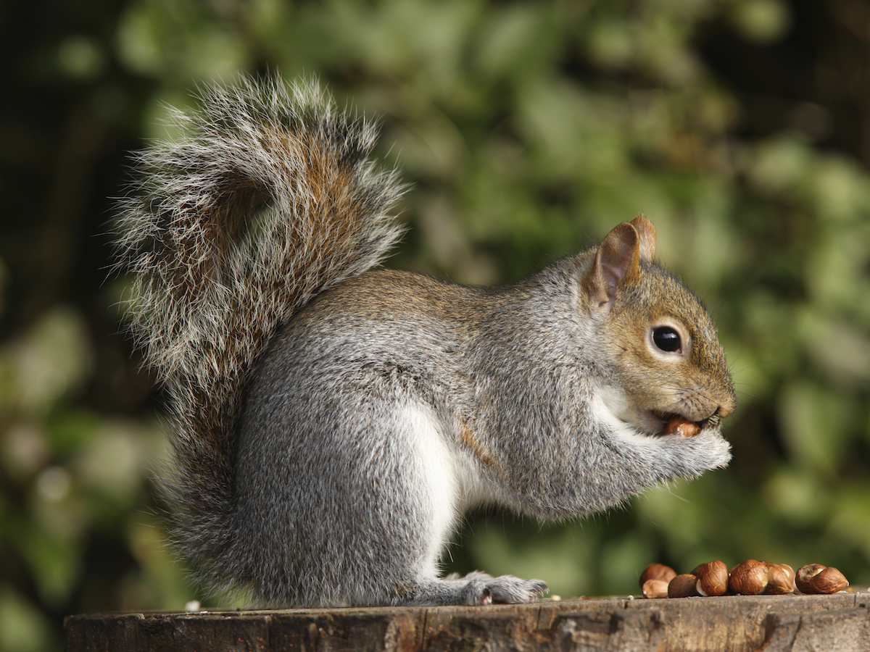
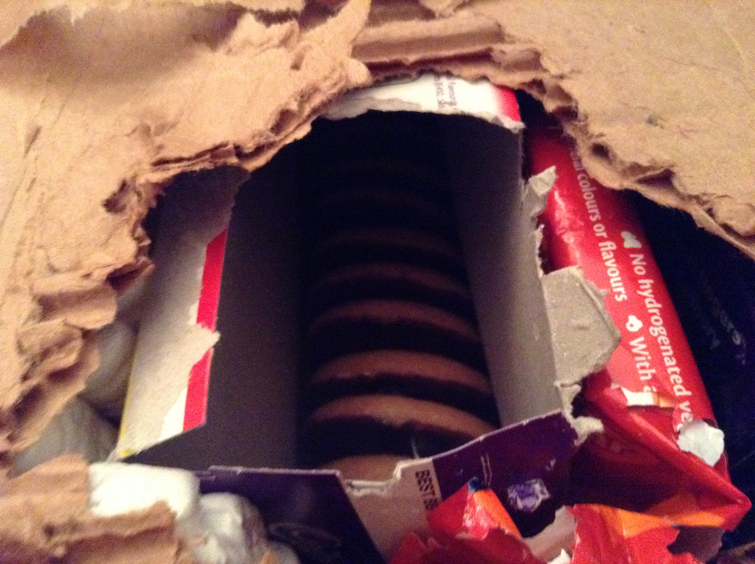
Background
Problem – squirrels causing havoc
Damage to plants, furniture, more
Looking for non-lethal repellant
Feedback - neighbor
Target market: consumer pest control
Homeowners in urban or suburban areas

Slide 3
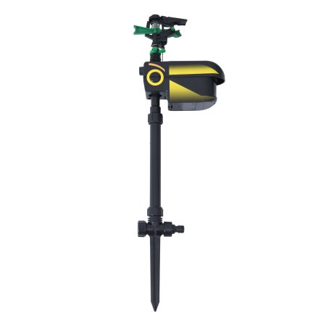
Methods/existing market
Water – Scarecrow Motion-Activated Animal Repellent
Visual (Decoys with motion) – Natural Enemy Scarecrow
Scent & Taste – Critter Ridder
Sound & Visual – The Guardian

Slide 4
Solution: ScarecrowBot
Detects squirrel using PIR motion sensor
Using a Piezo buzzer, the device emits an annoying sound to repel the squirrel
Also tracks detections and repeat events (another detection within 15 minutes or less of the earlier one)
Goal is to eliminate repeat event (return trip)
If repeat event occurs, the device automatically increases frequency (pitch) of sound to deter a return trip

Slide 5
Other features
Displays detection and repeat events with time stamp
Tracks count of the both detections and repeat events
Provides frequency
Allows user to adjust frequency on the fly
Allows user to put the device in deep sleep mode
Device data can be viewed in browser or iOS app

Slide 6
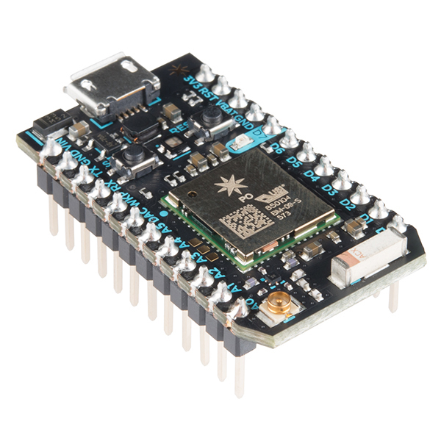
Hardware – Key components
Microcontroller/Board: Particle Photon
Reasons chosen:
Small footprint
Easy to use
WiFi (available in house and yard)
Storage and resources (1MB flash, 128KB RAM)

Slide 7
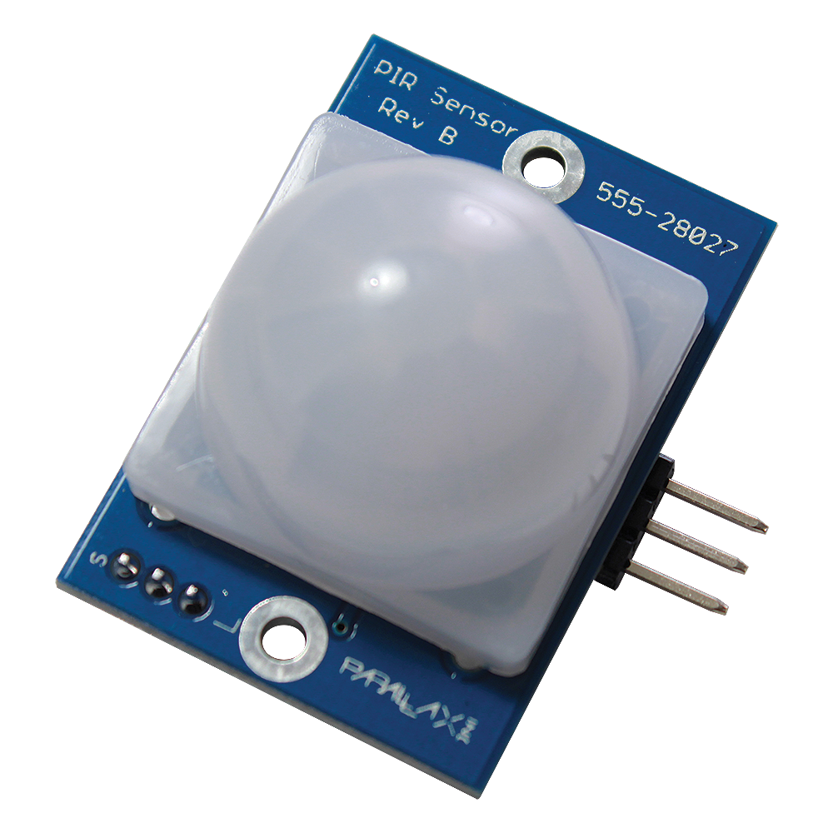
PIR Motion Sensor
PIR (Passive Infrared Sensor) – Is not active- makes no emissions nor uses a transmitter to sense
Detects emission or radiation of IR light from objects in it’s field of view
Reasons chosen:
More sensitivity than light/proximity sensors
Better range than other alternatives
Digital input

Slide 8
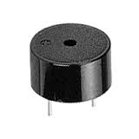
Piezo buzzer
Applies alternating electric current to material like ceramics which make tit vibrate – amplifies sounds using diaphragm or resonators
Reasons chosen:
Small footprint
Very cheap,
Easy to code using tone ()
Simple wiring
Wide range of frequencies—covers squirrel hearing spectrum

Slide 9
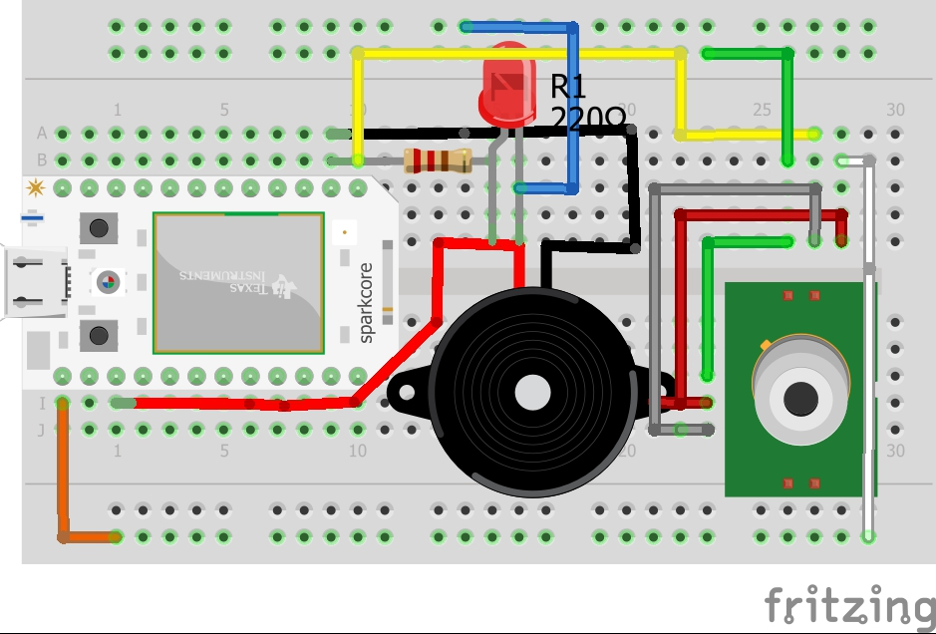
Breadboard layout

Slide 10
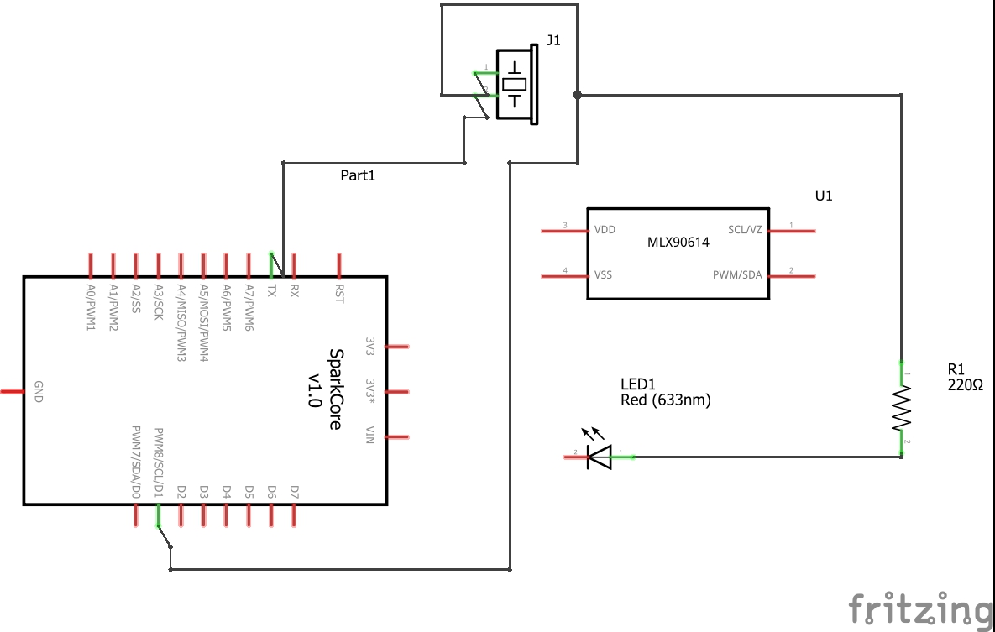
Schematic

Slide 11
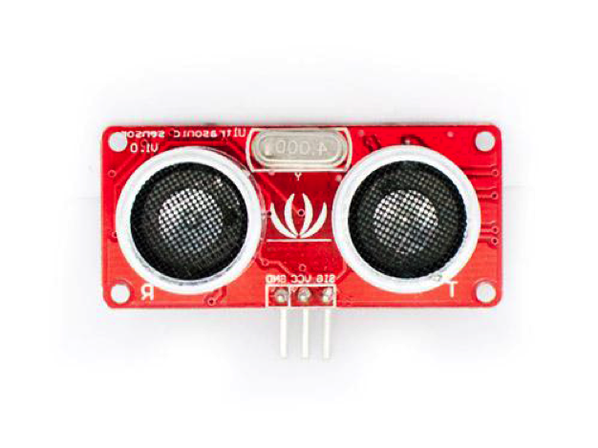
First Implementation
Started with identifying hardware needed (time to acquire)
Saw input sensors or detection as most important
Create key trigger event that makes all other data and functions possible
From data perspective, where in the process did the component fall?
Also, customer facing UI/app also important
Footprint of board/components big driver -- wanted to fit into/use enclosure

Slide 12
First Implementation
Originally planned to use Ultrasonic Range Finder in combination with PIR sensor
Range finder would kick out detection outside specified range in code
Reasons not chosen:
Minimal viable product
Footprint too large to fit on board
Running out of available connections
Limitations on distance in yard (not a high ceiling to test)

Slide 13
First Implementation
Considered coding an iPhone app but learning curve and time constraint prevented me to go beyond investigation
Also explored several third party platforms including IBM Bluemix (Watson), Blynk, and Microsoft Azure
Reasons not chosen:
Considerable or confusing setup
Libraries with issues (not compiling) – most time spent*
Lacking in support, resources, or community help

Slide 14
Next Iterations
Without the Ultrasonic sensor, made fundamental change to the device
Instead of range as a user defined variable, frequency can change
Reasons chosen:
MVP again – simplifying design and coding
Smaller footprint
Squirrels are more sensitive to higher frequencies than humans detecting as high as 49 MHz, buzzer's upper limit goes up to 65 Kho – high ceiling
The device can offer frequencies that squirrels could hear but not humans (max frequency heard `20kHz ) making the technology calmer.

Slide 15
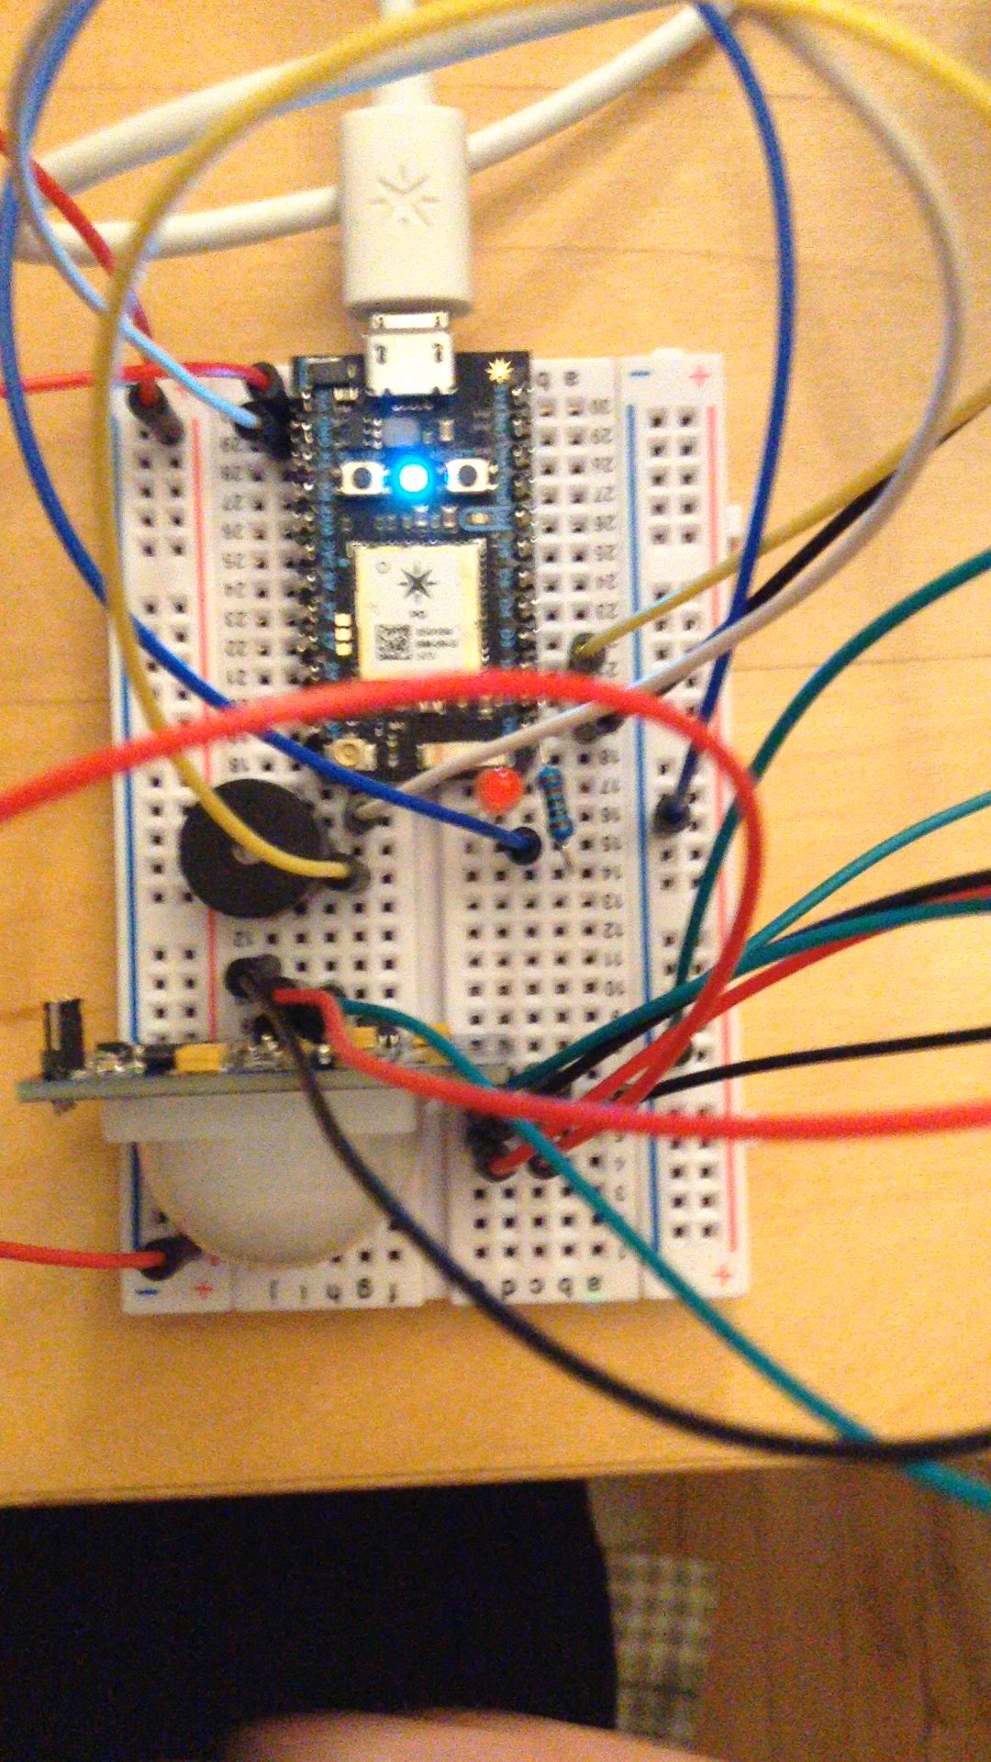
Next Iterations
Got motion sensor and buzzer working next
Simple detection of motion, then buzzer goes off
Iterative development – smallest, simplest chunk
Don’t try to do too much at once

Slide 16
Next iterations
Added logic for repeat events in code
Another detection occurs 15 min or < after previous one
Combination of conditional, Math and use of millis()
diff = millis() - firstCount;
if (detectCount > 1 && diff <= repeatTime) {
Particle.publish ("repeat");
repeatCount++;
Math easier to use in conditionals than with booleans

Slide 17
Next Iterations
Added logic for adjusting frequency
Tried smaller steps 20-30 Hz.
But not as noticeable to human ear.
User may think it’s not working
100 Hz is the step settled on

Slide 18
Next Iteration
Application/Collection Point-- wasted most time
Went with Porter App
Reasons chosen
Accepts Particle variables, events, and functions without libraries
Easy to use UI builder
Available iOS app as well as browser-based interface.
Other third party platforms such as Bluemix (IBM Watson IOT) and Blynk were difficult to setup and had problems with their libraries
Bright/Contrast has great support, very responsive

Slide 19
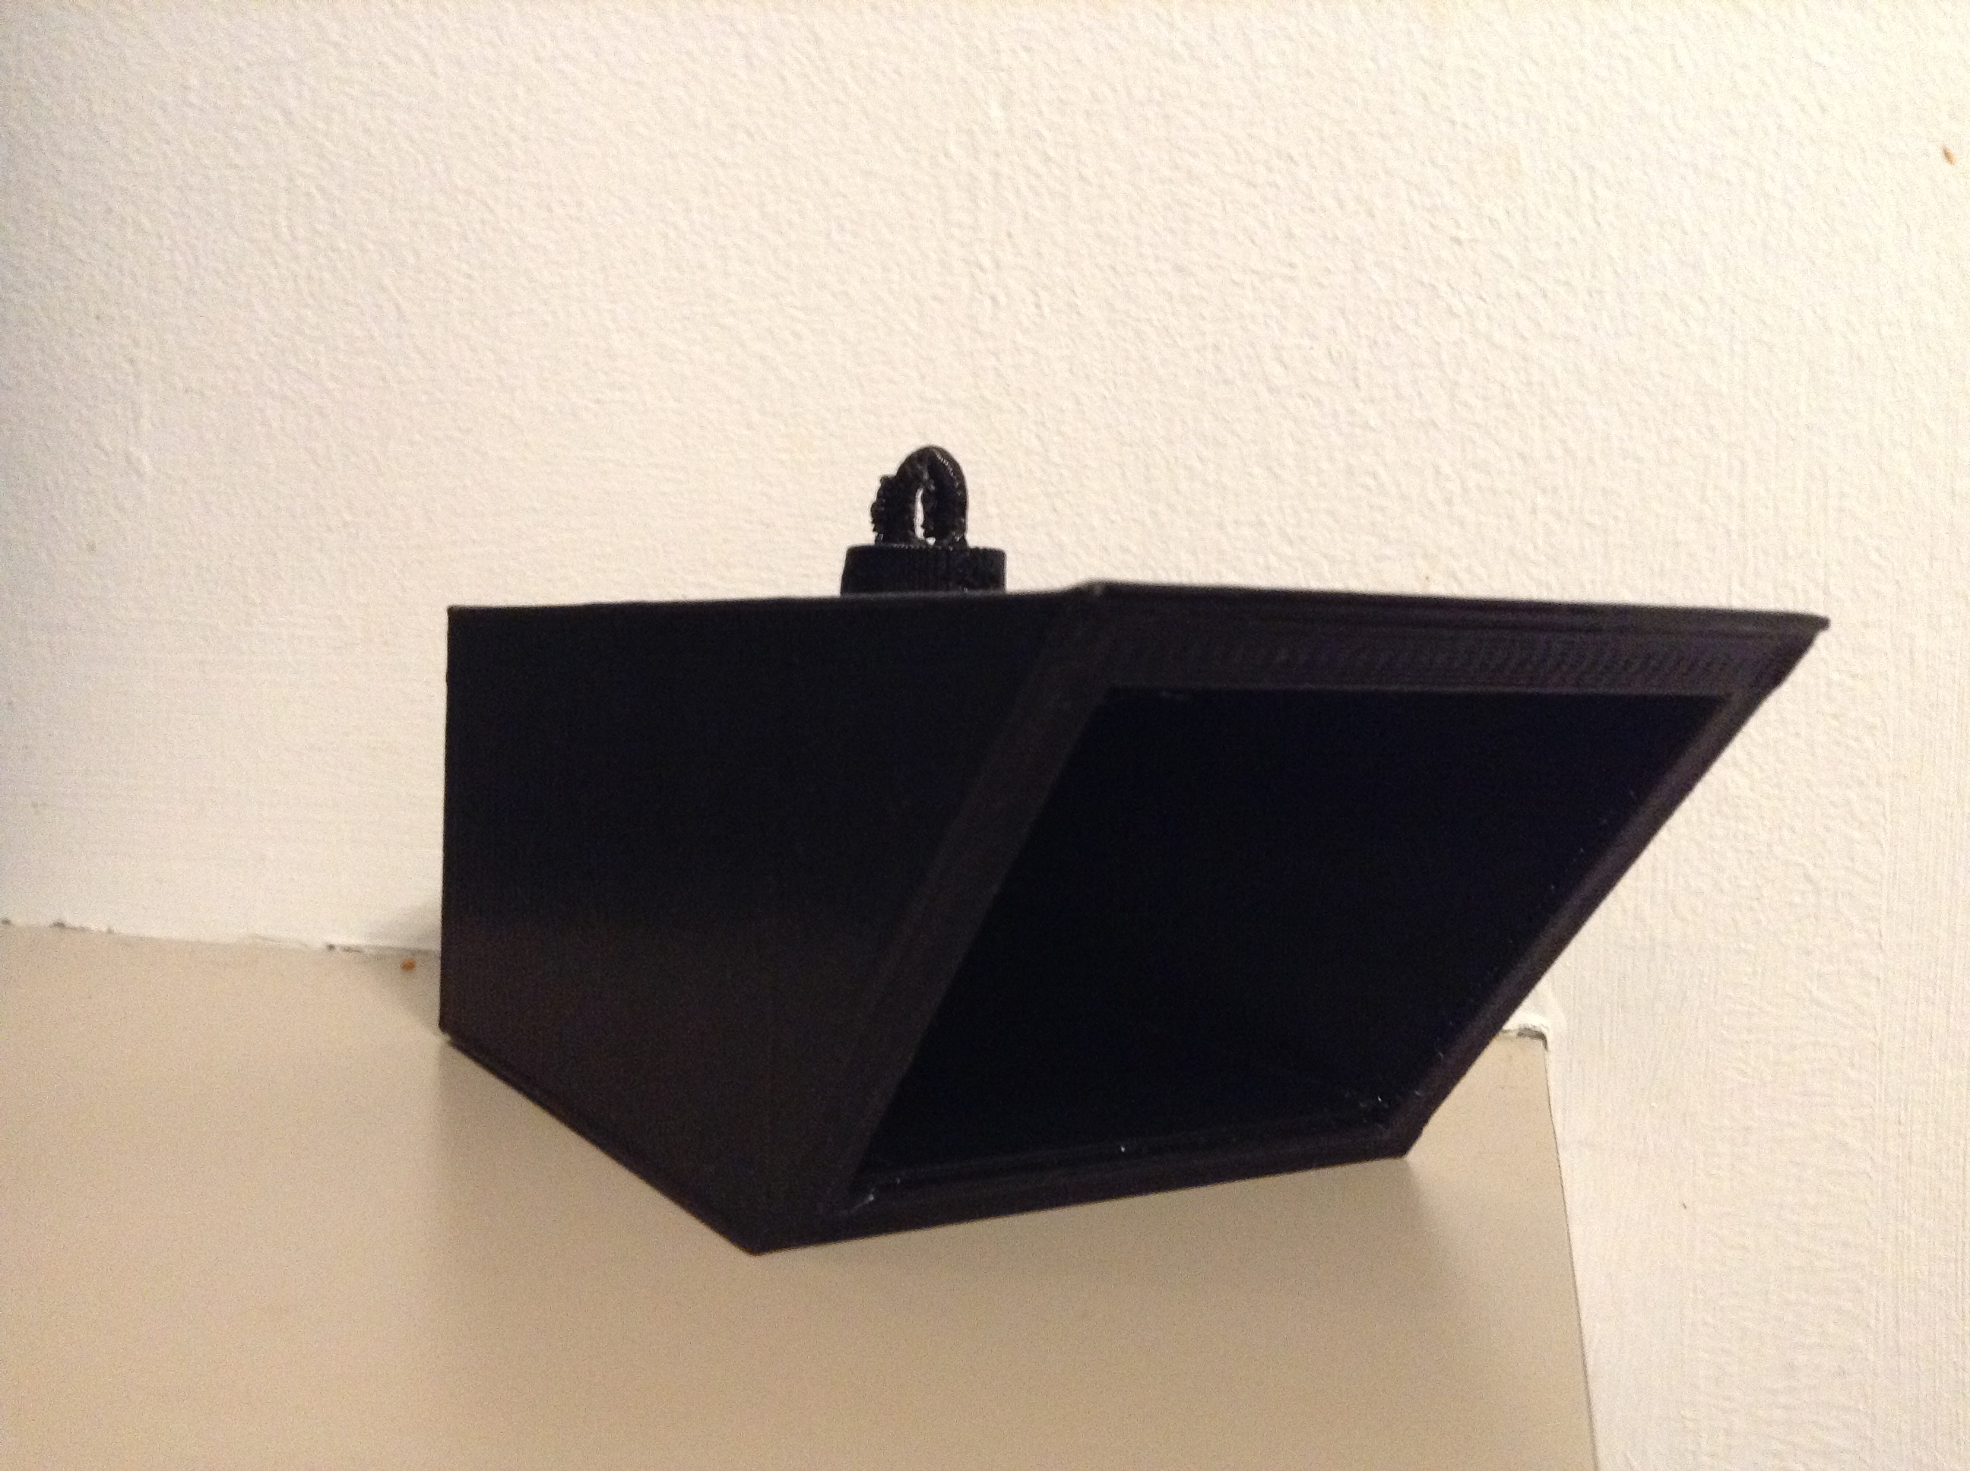
Enclosure

Slide 20
3D Printing
Design software often separate from printer software
Need .STL file for printer, but CAD or Step file for design
Design software varies greatly in complexity and features (Free CAD, LibreCAD and AutoCAD Fusion 360)
Fusion 360 had best combination of features and ease of use
Attempted to use existing model but wrong format
Had to build from scratch/made design simple

Slide 21
3D Printing
Helpful Hints (when ready to print)
Don’t use inserts or mats – just perf board
Always check nozzle and platform level before every attempt
Be ready to stop printing if something goes wrong
Printer settings are critical for time vs. quality tradeoff (thickness of layer, thin walls, raft, etc.) 2-12 hours

Slide 22
Final implementation
Frequency as user-defined variable (refined step to 100 Hz) – better implementation – can experiment with frequency
Sleep or power down (Deep Sleep worked best) – system sleep didn’t wake sometimes– had to reset device
Deep sleep worked every time as expected, appropriate for nighttime (as squirrels are active in daylight), simple code
Porter app best UI platform – designed for Photon, ease of use, support, and iOS app
AutoCAD Fusion 360 was the right design software for 3D printing model-great balance of feature set and ease of use

Slide 23
Scaling
Consider lower power options like a BLE device (average 80mA, 350 mA)
Option for ultra high frequency so that users cannot hear device go off but squirrels can.
Create a base that communicates with bots via BLE and base communicates via web with WiFi. After users place Bots they press on/off button to start advertising BLE signal. Then user presses register button to register all bots detected.
Create a injection-molded, NEMA-4 water tight design (Pendant shape good fit)
Only implemented deep sleep consider using system.sleep or standby when between detections – try Deep Sleep with Rising or activate pin
Consider using an automatically scalable cloud platform such as ASW IoT
Develop an HTML5/PHP/JavaScript web interface – mobile friendly, platform independent, degrades gracefully and easier to support

Slide 24
Security
Use Oauth to register users for UI application
Certificate for each device so you know what you are connecting to (AWS IOT has this)
Create a guest network
Turn off Universal Plug and Play – hackers can take advantage of this

Slide 25
Reliability
If BLE or WiFi goes down, device saves most recent detections and repeat event data and will upload to base when reconnected.
May require added storage/memory
Based backs up last 48 hours worth of the bot data and sends to cloud each day.
Identify an efficient battery for longer run time

Slide 26
Platform Management
After initial button push on base to register of each device, all updates are pushed through the base and then sent via BLE to all bots automatically.
Users access data from bots through platform-independent web application
Users register and use Oauth API for their system credentials

Slide 27
Quality User Experience
Bots have on/off button and base has single registration button to push and automatically registers all bots that are advertising
User interface is simple website with no installation required – just need a browser
Mobile friendly, platform detection allows all different devices from smartphone to tablets to desktops
Use of sliders, radio buttons, and dials for user interface. Make it easy to change things.

Slide 28
Lessons Learned
Always take a second look at design and reapply MVP- you may find low hanging fruit like I did with range finder – made huge improvements
Third party IoT platforms are challenging – complex setups, poor quality libraries and poor support or resources
Coding time logic syntax was difficult (Capital “T”)
System.sleep was problematic – sometimes could not wake up device (deep sleep was less of a problem)
Outdoor app – difficult to test (less controlled environment (bunny)
3D printer – settings for quality and speed critical and have a good design software
Sometimes you just have to cut something loose and find a workaround or alternative

